Slide 1
Zero Shot Learning
Omkar anil gune
Vision and image processing lab
EE, IIT Bombay

Slide 2
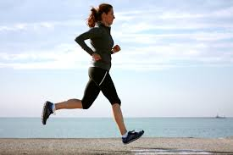
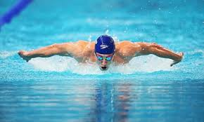
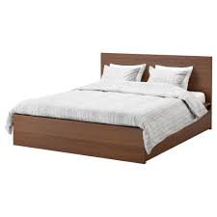




Visual Classification
Object recognition
Action recognition
Event recognition
Scene classification

Slide 3
Data driven techniques
Supervised learning
Unsupervised learning

Slide 4
Supervised learning
Training data with labels
Learn Classifier on training data

Slide 5
Supervised learning
Training data with labels
Learn Classifier on training data

Slide 6
Supervised learning
Use learned classifier on test data
Training and testing classes are same!

Slide 7
Unsupervised learning
No labels

Slide 8
Unsupervised learning
No labels
Clustering problem

Slide 9
Visual recognition challenge
ImageNet challenge
1000 object categories
365 scene categories
Activity Net
200 action classes
648 hours of video
Requirement of huge labeled data
Who gives this labels? Who gives the training data?

Slide 10
Zero shot learning as transfer learning
Learn on limited training data
Use some ‘side’ information
Transfer your learning to test data
Human ability to identify new (visual) samples from ‘side’ information

Slide 11
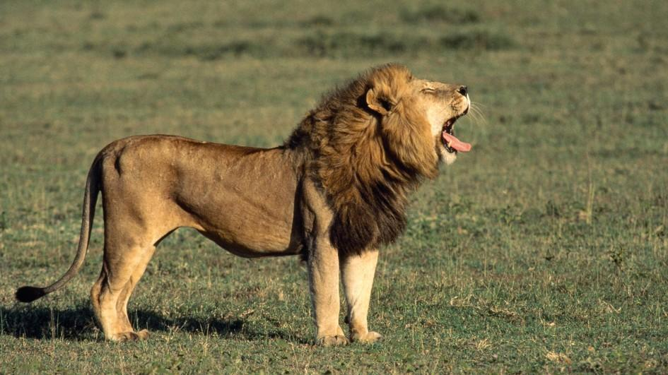
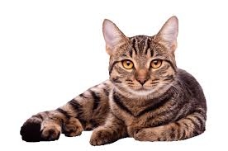
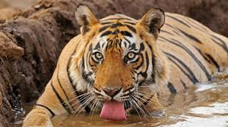
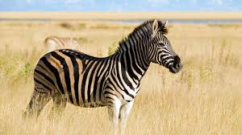
Identify these!

Slide 12
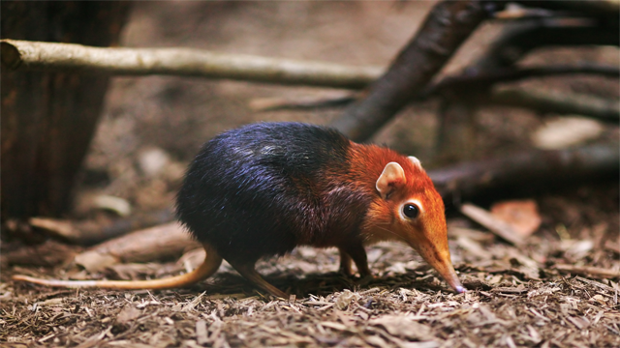
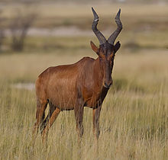
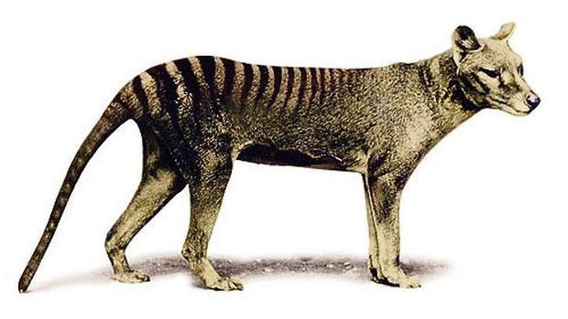
Identify these!

Slide 13
‘Side’ information
Hartebeest*: An African antelope, large animal, elongated foreheads, oddly shaped horns, shot neck, pointed ears…
Elephant shrew*: Small, quadrupedal, insectivorous mammals resembling rodents or opossums, with scaly tails, elongated snouts, and rather long legs for their size, …
Tasmanian tiger*: Appearance of a medium-to-large-size dog, except for its stiff tail and abdominal pouch (reminiscent of a kangaroo) and dark transverse stripes that radiated from the top of its back, similar to those of a tiger …
*Description from Wikipedia

Slide 14
Now identify these!

Slide 15
Now identify these!
Hartebeest: An African antelope, large animal, elongated foreheads, oddly shaped horns, shot neck, pointed ears…
Elephant shrew: Small, quadrupedal, insectivorous mammals resembling rodents or opossums, with scaly tails, elongated snouts, and rather long legs for their size, …
Tasmanian tiger: Appearance of a medium-to-large-size dog, except for its stiff tail and abdominal pouch (reminiscent of a kangaroo) and dark transverse stripes that radiated from the top of its back, similar to those of a tiger …

Slide 16
‘Side’ information
Non-visual information
Relatively easy to obtain
Higher dimensional vector representation for a class label
Examples:
Attributes: has legs, has tail, has two eyes, is black, …
Word2vec: vector representation for each English dictionary word based on context
Semantic space ‘Side’ information Class prototypes

Slide 17
What is zero shot learning ?
Seen classes: labeled data available, training classes, ‘side’ information available
Unseen classes: no training data (zero shot), test classes, ‘side’ information available
Seen classes different than unseen classes
Use of ‘side’ information: semantic space
Seen classes
Unseen classes
Semantic space
(side information)

Slide 18
Zero shot learning: Training
Seen class prototypes
Visual feature space
Semantic embedding space (Side information)

Slide 19
Zero shot learning: Training
Seen class prototypes
Learn mapping f
Visual feature space
Semantic embedding space
(Side information)

Slide 20
Zero shot learning: Testing
Seen class prototypes
learned f
Test sample
Visual feature space
Semantic embedding space
(Side information)

Slide 21
Zero shot learning: Testing
Seen class prototypes
Unseen class
prototypes
learned f
Test sample
Visual feature space
Semantic embedding space
(Side information)

Slide 22
Zero shot learning
Training: Given visual features x and seen class prototypes v, find mapping function f
f: x v
Testing: Given visual feature x_t and unseen class prototypes, find embedding f(x_t)
Nearest neighbor matching of f(x_t) with unseen class prototypes
f : Multidimensional regression function

Slide 23
Back to ‘side’ information
Who gives this ‘side’ information? Or class prototypes
Manually defined attributes, needs expert knowledge
Unsupervised way: word2vec
Latent attributes/data driven

Slide 24
Challenges
How to learn multidimensional mapping function ?
Which semantic space would fit well ?
Which attributes should be used?
Seen and unseen classes different > domain shift

Slide 25
What do we have: domain shift
Training: Given visual features x and seen class prototypes v, find mapping function f: x→ v
*Image Source: Transductive
Multiview embedding for zero
Shot recognition and annotation
ECCV 2014

Slide 26
What do we want?
Training: Given visual features x and seen class prototypes v, find mapping function f: x→ v
*Image Source: Transductive
Multiview embedding for zero
Shot recognition and annotation
ECCV 2014

Slide 27
Domain shift
Use multiple semantic spaces (multiple ‘side’ information)
Attributes space
Word2vec space
Each semantic space has its own domain shift
Multiple domain shifts at rescue!
Method: Fu et al., Transductive multiview embedding for zero shot recognition and annotation, ECCV 2014

Slide 28
Domain shift: Multiview embedding
Training
Learn mapping function from visual feature (x) space to attribute (a) space
fa: x → a
Learn mapping function from visual feature (x) space to word2vec (v) space
fv: x → v

Slide 29
Domain shift: Multiview embedding
Testing
Visual feature xt
fa
Attribute space

Slide 30
Domain shift: Multiview embedding
Testing
Visual feature xt
fa fv
Attribute space
Word2vec space

Slide 31
Domain shift: Multiview embedding
Testing
Visual feature xt
fa fv
Attribute space
Word2vec space
Common embedding space

Slide 32
Domain shift: Multiview embedding
Testing
all test (visual) features xt
fa fv
Attribute space
Word2vec space
wa
wx
wv
Common embedding space

Slide 33
Domain shift: Multiview embedding
Testing
all test (visual feature) xt
fa fv
Attribute space
Word2vec space
wa
wx
wv
Common embedding space

Slide 34
Domain shift: Multiview embedding
Testing
Visual feature xt
fa fv
Attribute space
Word2vec space
Subspace alignment
wa
wx
wv
Common embedding space

Slide 35
Domain shift: Multiview embedding
Graph for attributes

Slide 36
Domain shift: Multiview embedding
Graph for attributes
Graph for word2vec

Slide 37
Domain shift: Multiview embedding
Label propagation
Graph for attributes
Graph for word2vec

Slide 38
Summary
Supervised learning: need for huge labeled training data
Labeling data: time consuming task, can not scale for all object/action classes
Zero shot learning: knowledge transfer from training to testing classes
No training sample for test class
Use of ‘side’ information
Challenges: choice of semantic space, domain shift etc.

Slide 39
Thank You

Slide 40
